Slide 1
Sales Report On POWER BI
- Devansh Shrivastava

Slide 2
AGENDA
Project Overview
Project Objective
Dataset Overview
Content Explanation
Sales Forecasting
Summary

Slide 3
Project Overview
In this data-driven project, we embarked on a transformative journey to leverage unstructured data from Excel, seamlessly integrating it into Power BI to establish a comprehensive Super Sales Dashboard. The project's primary objective was to empower stakeholders with intuitive insights, facilitating informed decision-making in the realm of sales and business operations.

Slide 4
PROJECT OBJECTIVE
Data Integration and Cleaning
Visual Aesthetics and User Experience
Key Performance Indicators (KPIs) Derivation
Forecasting Techniques
Integration of Data Science and Analytics

Slide 5
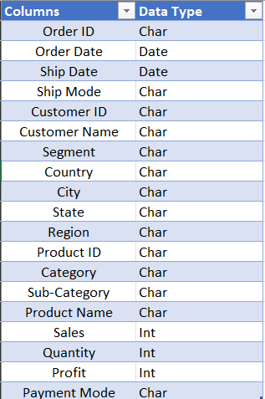
DATA SET OVERVIEW
Data is given in the form of Excel sheets having Field names as
Order ID, Order Date, Ship Date, Ship Mode, Customer ID, Customer Name,
Segment, Country, City, State, Region, Product ID, Category, Sub-Category,
Product Name, Sales, Quantity, Profit, Returns, Payment Mode. Identifying the column which have no relevance with the targeting result should be removed.

Slide 6
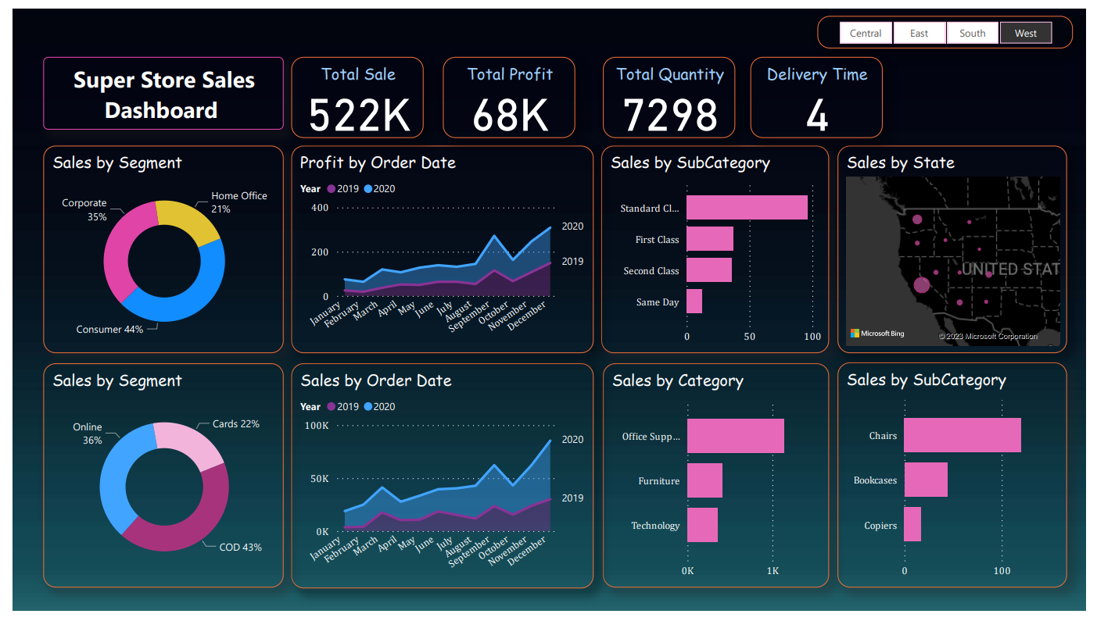
Richard Branson

Slide 7
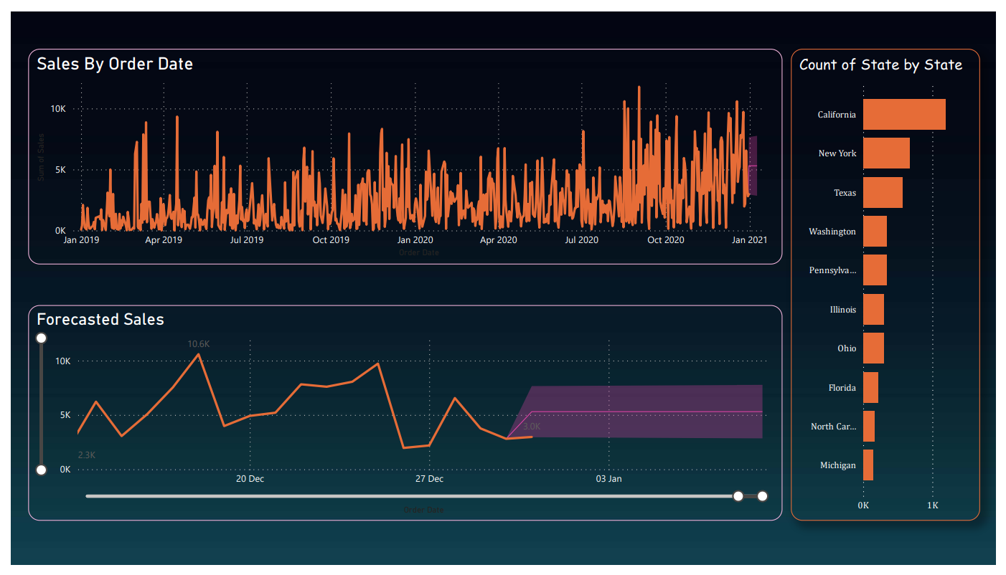

Slide 8

Content in Sales Report
KPI : - A Key Performance Indicator (KPI) is a quantifiable metric that measures the performance of a business.
It is critical for assessing the effectiveness of strategies, tracking progress, and facilitating data-driven
decision-making.
In this Sales Report I have used four KPIs Total Sales, Total Profit, Total Quantity and Average Delivery Time.
As these criteria contribute a lot in Business.

Slide 9
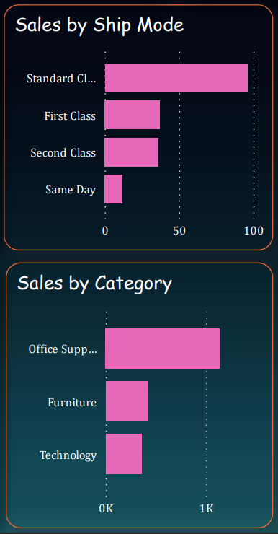
Clustered Bar Graph :- Bar graph is used to show values across categories. Here we used to represent Sales by category, Sales by Sub-Category.
Top 4 Sub-category based on Ship Mode.
Top 3 categories based on Sales.

Slide 10
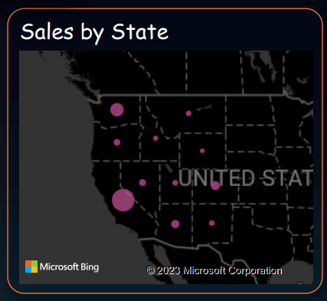
Maps in Power BI :- It visually represent sales data geographically. This visualization aids in identifying sales hotspots, regional preferences, and potential areas for market expansion. Geospatial analysis through maps enhances the understanding of sales patterns and supports targeted decision-making for regional optimization and marketing strategies.
Geographical representation of sales by state, offering insights
into regional performance and potential market expansion.

Slide 11
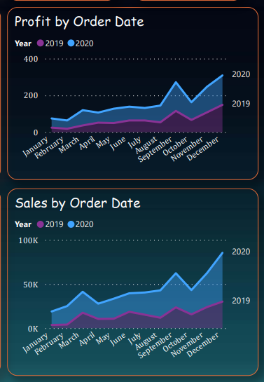
Line Chart in Power BI :- is used to display trends and patterns over time. It shows how a numerical variable changes continuously, making it effective for visualizing and analyzing time-series data.
Line chart is used here to represent Profit by order date.
Here we combined two years data i.e., 2019 and 2020.
Line chart is used here to represent Sales by order date.
Here we combined two years data i.e., 2019 and 2020.

Slide 12
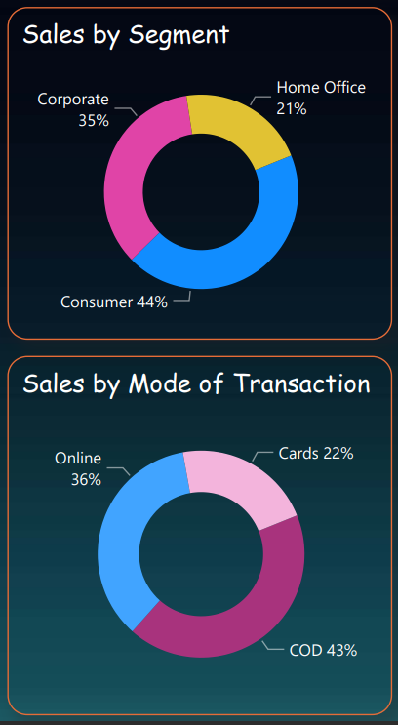
Donut Chart in Power BI :- It is a circular visualization that conveys proportional relationships within a dataset. Donut charts are useful for showcasing the distribution of parts relative to the whole, emphasizing the data's composition while maintaining a clean and easy-to-read visual format.
Donut chart represent a proportional relationships of sales
by Segments.
Donut chart represent a proportional relationships of sales
By Mode of Transaction.

Slide 13
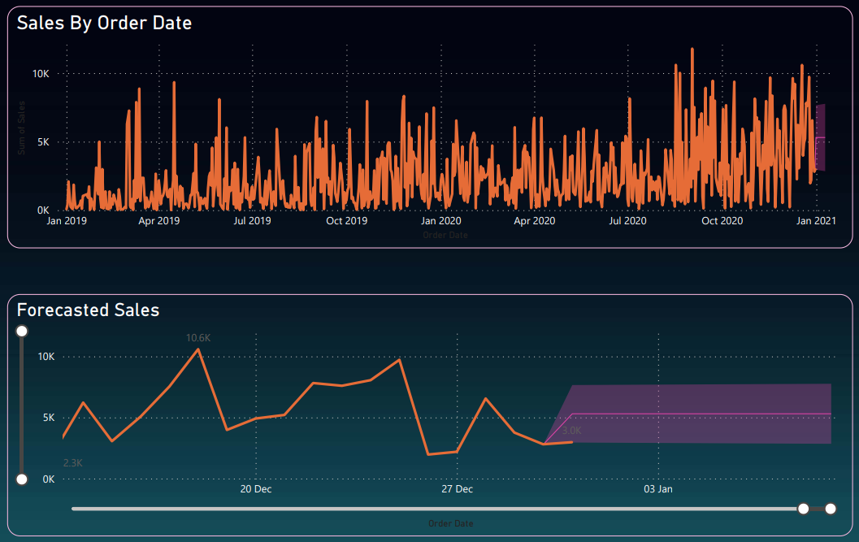
Line Chart :- It is a valuable tool for sales forecasting. By plotting historical sales data and utilizing forecasting tools,
it provides a visual projection of future trends. The line chart's trend line extends into the future,
aiding in predicting potential sales outcomes.
Forecasted Sales for Next 16 Days

Slide 14
SUMMARY
The Super Sales Dashboard provides a comprehensive view of the business's performance, enabling stakeholders to make data-driven decisions across various aspects of the sales operation. The combination of KPIs, visualizations, and forecasting empowers the team to respond proactively to market dynamics, optimize operations, and drive strategic growth.

Slide 15
THANK YOU
Devansh Shrivastava
shrivastavadevansh288@gmail.com
GitHub

